Slide 1

Neumann and insulated boundary conditions

Slide 2
Introduction
In this topic, we will
  Review Neumann boundary conditions
  Approximate derivatives using the formula from calculus
  Author a solution in Matlab using this approximation
  Observe there are weaknesses in such an approach
  Consider a superior approach

Slide 3
Dirichlet boundary conditions
Up to this point, we’ve used Dirichlet boundary conditions:
Recall that this affected the first and last equations:

Slide 4
Neumann and insulated boundary conditions
What happens if a boundary has an insulated or more generally a Neumann boundary condition?

Slide 5
Neumann and insulated boundary conditions
Suppose we have a Neumann boundary condition at x = a:
  How do we eliminate the unknown u₀?
  If we don’t eliminate it, we will have fewer equations than unknowns…

Slide 6
Approximating the derivative
Recall we used a divided-difference approximation of the derivative:
  But u(a) ≈ u₀ and u(a + h) ≈ u₁:
  Thus, we have an equation

Slide 7
Approximating the derivative
Thus, if we have a left-hand Neumann condition, we have
  Substituting the second into the first yields
  Thus, entry (1,1) of the matrix needs to be updated and
  entry 1 of the target vector needs to be updated

Slide 8
Approximating the derivative
Similarly, we can find on the right-hand boundary value:
  This yields
  Thus, entry (n – 1, n – 1) of the matrix needs to be updated and entry n – 1 of the target vector needs to be updated

Slide 9
Implementation
  function [xs, us] = bvp( a2, a1, a0, g, x_rng, u_bndry, dirichlet, n )
  h = (x_rng(2) - x_rng(1))/n;
  p = @(x)( 2.0*a2(x) - a1(x)*h );
  q = @(x)(-4.0*a2(x) + 2.0*a0(x)*h^2);
  r = @(x)( 2.0*a2(x) + a1(x)*h );
  xs = linspace( x_rng(1) + h, x_rng(2) - h, n - 1 )';
  A = zeros( n - 1, n - 1 );
  for k = 1:(n - 1)
  A(k, k) = q(xs(k));
  end
  for k = 1:(n - 2)
  A(k + 1, k ) = p(xs(k + 1));
  A(k, k + 1) = r(xs(k));
  end

Slide 10
Implementation
  v = 2.0*g( xs )*h^2;
  if dirichlet( 1 )
  v(1) = v(1) - p(xs(1))*u_bndry(1);
  else
  A(1, 1) = A(1, 1) + p(xs(1));
  v(1) = v(1) + p(xs(1))*u_bndry(1)*h;
  end
  if dirichlet( 2 )
  v(end) = v(end) - r(xs(end))*u_bndry(2);
  else
  A(end, end) = A(end, end) + r(xs(end));
  v(end) = v(end) - r(xs(end))*u_bndry(2)*h;
  end

Slide 11
Implementation
  us = A \ v;
  xs = [x_rng(1); xs; x_rng(2)];
  if dirichlet( 1 )
  us = [u_bndry(1); us];
  else
  us = [us(1) - u_bndry(1)*h; us];
  end
  if dirichlet( 2 )
  us = [us; u_bndry(2)];
  else
  us = [us; us(end) + u_bndry(2)*h];
  end
  end

Slide 12
Example
Let us examine this bvp:
If n = 10, then h = 0.2, so
As before,
the x-values are –1, –0.8, –0.6, –0.4, –0.2, 0, 0.2, 0.4, 0.6, 0.8, 1

Slide 13
Example
We can call our function with the appropriate arguments:
  >> [xs, us] = bvp( @(x)(x^2*13), @(x)(-5.0), @(x)(8*x),...
  @sin, [-1 1], [-0.4738221764482897 2], ...
  [false, true], 10 )

Slide 14
Example
Solving this system of linear equations yields:

Slide 15
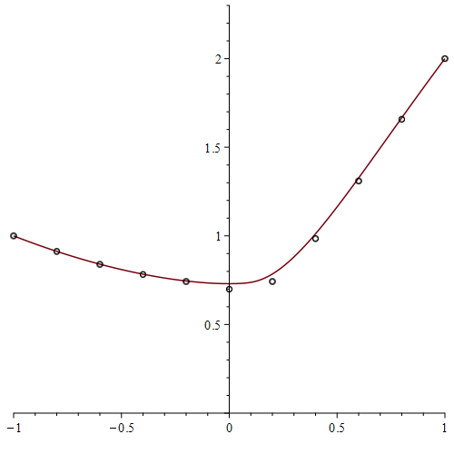
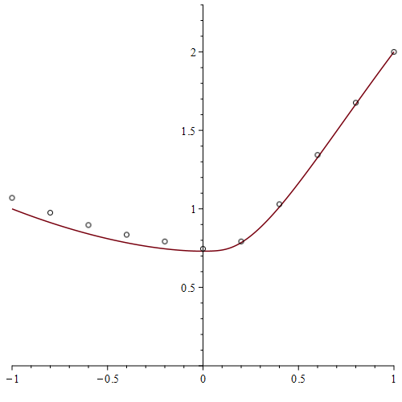
Example
Here is a plot of the solution and the approximations:

Slide 16
Error analysis
Problem:
  When we substituted the derivative and second derivative,
  we used O(h²) approximations
  When we approximated the derivatives,
  we used O(h) approximations
  Consequently, the overall error will now be O(h)

Slide 17
An O(h²) approximation
Recall we used a divided-difference approximation of the derivative:

Slide 18
Implementation
  function [xs, us] = bvp( a2, a1, a0, g, x_rng, u_bndry, dirichlet, n )
  h = (x_rng(2) - x_rng(1))/n;
  p = @(x)( 2.0*a2(x) - a1(x)*h );
  q = @(x)(-4.0*a2(x) + 2.0*a0(x)*h^2);
  r = @(x)( 2.0*a2(x) + a1(x)*h );
  xs = linspace( x_rng(1) + h, x_rng(2) - h, n - 1 )';
  A = zeros( n - 1, n - 1 );
  for k = 1:(n - 1)
  A(k, k) = q(xs(k));
  end
  for k = 1:(n - 2)
  A(k + 1, k ) = p(xs(k + 1));
  A(k, k + 1) = r(xs(k));
  end

Slide 19
Implementation
  v = 2.0*g( xs )*h^2;
  if dirichlet( 1 )
  v(1) = v(1) - p(xs(1) )*u_bndry(1);
  else
  A(1, 1) = A(1, 1) + (4.0/3.0)*p(xs(1));
  A(1, 2) = A(1, 2) - (1.0/3.0)*p(xs(1));
  v(1) = v(1) + (2.0/3.0)*p(xs(1))*u_bndry(1)*h;
  end
  if dirichlet( 2 )
  v(end) = v(end) - r(xs(end))*u_bndry(2);
  else
  A(end, end-1) = A(end, end-1) - (1.0/3.0)*r(xs(end));
  A(end, end) = A(end, end) + (4.0/3.0)*r(xs(end));
  v(end) = v(end) - (2.0/3.0)*r(xs(end))*u_bndry(2)*h;
  end

Slide 20
Implementation
  us = A \ v;
  xs = [x_rng(1); xs; x_rng(2)];
  if dirichlet( 1 )
  us = [u_bndry(1); us];
  else
  us = [(-1.0/3.0)*us(2) + (4.0/3.0)*us(1) ...
  - (2.0/3.0)*u_bndry(1)*h; us];
  end
  if dirichlet( 2 )
  us = [us; u_bndry(2)];
  else
  us = [us; (-1.0/3.0)*us(end-1) + (4.0/3.0)*us(end) ...
  + (2.0/3.0)*u_bndry(2)*h];
  end
  end

Slide 21
Example
Solving this system of linear equations yields:

Slide 22
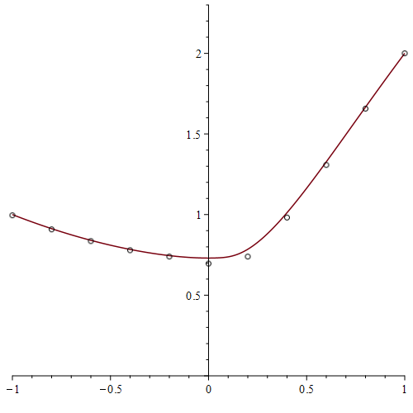
Example
The O(h) approximation is on the left,
the O(h²) approximation is on the right

Slide 23
Insulated boundary conditions
Recall that insulated boundary conditions are when the derivatives are zero
  Consequently, only the matrix is modified,
  as the change to the target vector is zero
0
0

Slide 24
Summary
Following this topic, you now
  Understand better what Neumann conditions are
  Understand that better approximations cannot compensate for poorer approximations
  Know how to approximation a bvp with Neumann conditions
  Have gone through an implementations in Matlab
  Have seen an example

Slide 25
References
[1] https://en.wikipedia.org/wiki/Finite_difference_method

Slide 26
Acknowledgments
None so far.

Slide 27



Colophon
These slides were prepared using the Cambria typeface. Mathematical equations use Times New Roman, and source code is presented using Consolas. Mathematical equations are prepared in MathType by Design Science, Inc.
Examples may be formulated and checked using Maple by Maplesoft, Inc.
The photographs of flowers and a monarch butter appearing on the title slide and accenting the top of each other slide were taken at the Royal Botanical Gardens in October of 2017 by Douglas Wilhelm Harder. Please see
https://www.rbg.ca/
for more information.

Slide 28
Disclaimer
These slides are provided for the ece 204 Numerical methods course taught at the University of Waterloo. The material in it reflects the author’s best judgment in light of the information available to them at the time of preparation. Any reliance on these course slides by any party for any other purpose are the responsibility of such parties. The authors accept no responsibility for damages, if any, suffered by any party as a result of decisions made or actions based on these course slides for any other purpose than that for which it was intended.

